Slide 1

SpotCheckAI: Sprint 1 Presentation
Rafferty Leung

Slide 2
Agenda
Team Member Roles and Responsibilities
Problem Statement/Description
Team Working Agreement
Personas
Minimum Viable Product
Technologies Implemented
Algorithms Employed
Diagrams
Product Backlog
Sprint 1 Backlog
Metrics
Retrospective
Sprint 2
MVP Demo

Slide 3
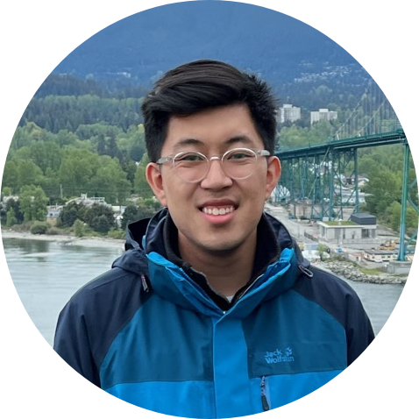
Team Roles and Responsibilities
Responsibilities:
Write and test code to ensure high-quality software that meets requirements.
Troubleshoot and debug code to identify and fix issues.
Ensure software scalability, performance, and security.
Work with project managers to estimate development efforts and deliver on time.
Define and prioritize the product roadmap and features based on user needs and market trends.
Gather and analyze user feedback and market research to inform product decisions.
Create and manage product requirements and specifications.
Rafferty Leung
Software Engineer, Product Manager

Slide 4
Problem Statement
The average wait time to see a physician is currently 26 days, and the process of diagnosing skin cancer can cause delays in treatment due to the need for a dermatology appointment, visual inspection, and pathology review. To address this issue, a proposed solution involves using machine learning algorithms to triage patients based on skin lesion images. This approach has the potential to identify cases with a higher certainty of being cancerous, allowing those patients to be prioritized for earlier appointments and reducing wait times while improving patient outcomes.

Slide 5
Project Description
For individuals concerned about the potential malignancy of skin lesions,
who want a faster and more convenient alternative to traditional diagnostic methods,
the SpotCheckAI progressive web application (PWA)
is a solution
that allows users to upload an image and receive a response that predicts the likelihood of the lesion being cancerous or benign, providing preliminary responses to the end-user and streamlining a physician’s practice
unlike existing solutions that may have limited accuracy or accessibility,
our application’s machine learning model provides a highly accurate and user-friendly experience with the added benefit of being open source, allowing for further development and improvement of the machine learning model.

Slide 6
Team Working Agreement
Participation
It is expected of all members of the team to arrive promptly for meetings and actively participate during the meeting.
Daily participation in the sprint cycles is required.
Communication
The team will utilize Slack, LinkedIn Messaging, or Email for communication, ensure codebase maintenance, and uphold transparency by openly addressing any obstacles or concerns they encounter.
Work Division
The distribution of work and project responsibilities will be fair and equal, and each sprint will reflect this approach.

Slide 7
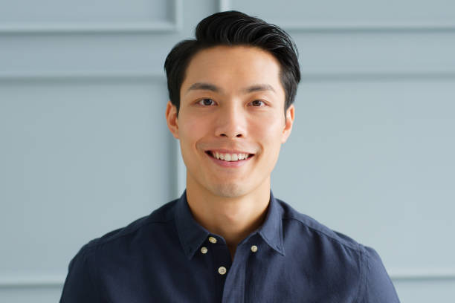
Persona 1
Name: David Kim
Age: 42
Occupation: Construction Project Manager
Education: Bachelor's degree in Civil Engineering
Personality: David is a hard-working and responsible individual who takes pride in his work. He is a detail-oriented person who pays close attention to his surroundings and is always looking for ways to improve processes. He is also health-conscious and enjoys staying active by jogging and playing basketball with his friends.
Interests: David is interested in technology and enjoys exploring new apps and software. He is also an advocate for sun safety and spends a lot of time outdoors due to his job, which has increased his risk of skin cancer. He enjoys learning about new ways to protect his skin and stay healthy.
Goals: David's main goal is to excel in his career and take on larger construction projects. He also wants to continue leading an active and healthy lifestyle, which includes monitoring his skin for signs of skin cancer. He hopes to use technology to help him achieve his health goals and stay informed about the latest developments in sun protection.
Challenges: David faces challenges in balancing his demanding job with his personal life. He also struggles with keeping track of his skin health, as it can be difficult to remember to check his skin for changes regularly. He hopes to use a skin cancer detection app to help him monitor his skin and catch any potential issues early on. However, he is also concerned about the accuracy of such apps and wants to ensure that he is using a reliable and trustworthy tool.

Slide 8

Persona 2
Name: Emily Rodriguez
Age: 29
Occupation: Outdoor Recreation Guide
Education: Associate's degree in Outdoor Recreation
Personality: Emily is a nature enthusiast who is passionate about sharing her love of the outdoors with others. She is outgoing and adventurous, and enjoys exploring new trails and camping sites. She is also conscientious and takes her responsibility for the safety of her clients seriously.
Interests: Emily enjoys hiking, backpacking, and rock climbing in her free time. She is also interested in technology and is always looking for ways to use it to enhance her clients' experiences. She is particularly interested in skin cancer prevention and is looking for ways to incorporate sun safety into her job.
Goals: Emily's main goal is to help her clients have a safe and enjoyable experience in the great outdoors. She also hopes to use technology to help her monitor her own skin health and catch any potential issues early on. Additionally, she wants to continue exploring new outdoor adventures and sharing them with others.
Challenges: Emily faces challenges in keeping track of her skin health while spending long hours outdoors. She hopes to use a skin cancer detection app to help her monitor any changes in her skin but is concerned about the reliability of such tools. She also struggles with work-life balance at times, as her job requires her to spend long hours in the outdoors.

Slide 9

Persona 3
Name: Thomas Lee
Age: 45
Occupation: Sales Manager
Education: Bachelor's degree in Marketing
Personality: Thomas is a confident and charismatic person who enjoys interacting with people. He is skilled at building relationships and is always looking for ways to improve his sales numbers. He is also health-conscious and takes his sun safety seriously.
Interests: Thomas enjoys playing golf and is a member of a local golf club. He also enjoys traveling with his family and experiencing new cultures. He is interested in technology and is always looking for ways to use it to improve his work and personal life.
Goals: Thomas's main goal is to increase his sales and advance in his career. He also hopes to use technology to help him monitor his skin health and catch any potential issues early on. Additionally, he wants to continue playing golf and spending time with his family.
Challenges: Thomas faces challenges in keeping track of his skin health while spending long hours outdoors meeting with clients. He hopes to use a skin cancer detection app to help him monitor any changes in his skin but is concerned about the accuracy of such tools. He also struggles with work-life balance at times, as his job requires him to travel frequently and spend long hours working.

Slide 10
Minimum Viable Product
A website that allows for simple input and output with a predicted degree of certainty.
Implementation of a Machine Learning Model with sufficient testing and training sample size.
A cross-platform website that is responsive and device agnostic.

Slide 11
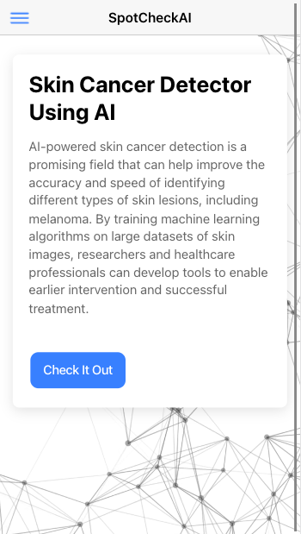
MVP: Home Page
Overview of what application’s functionality
Prediction form accessibility

Slide 12
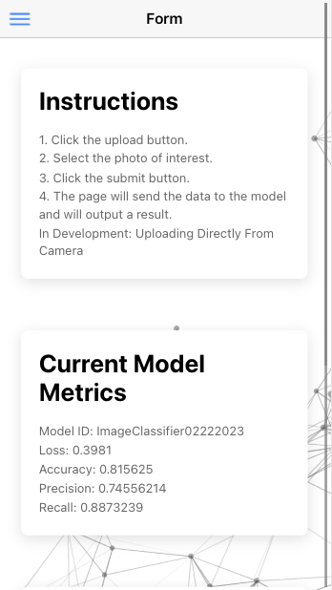
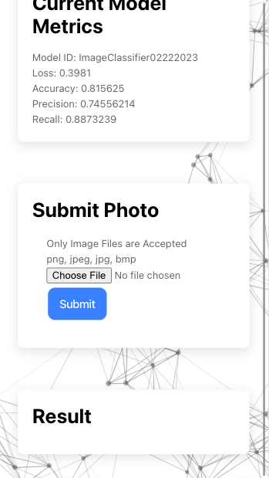
MVP: Prediction Form
Instructions
Current Model Metrics
Submit Photo
Specified image type criteria
Result
Will return result with prediction or HTTP Error Message

Slide 13
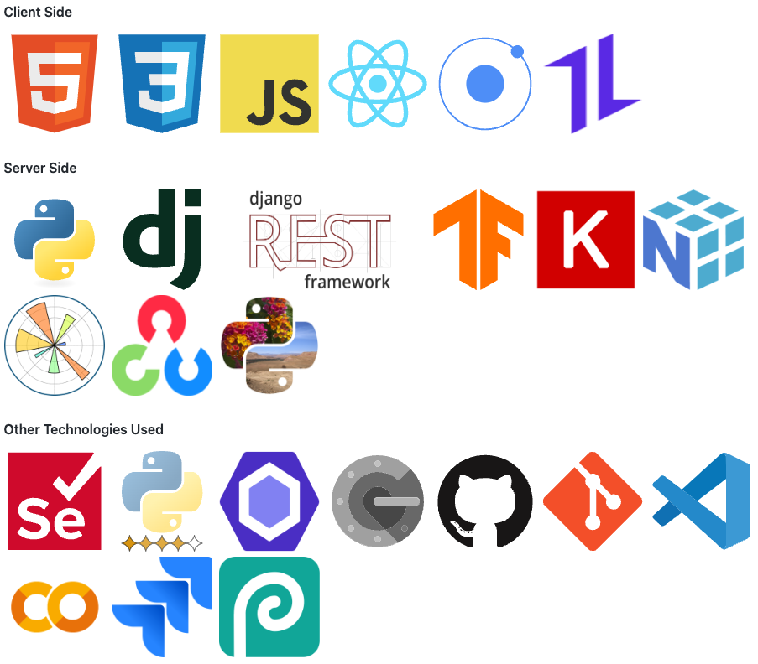
Current Technologies Utilized

Slide 14

Algorithm: CNN
Image Recognition → Convolution Neural Network
Three separate ”stacks” of 2D layers:
Convolution Layer with ReLU activation
Max Pooling Layer
Drop Out Layer
Flatten Layer
Dense Layer

Slide 15
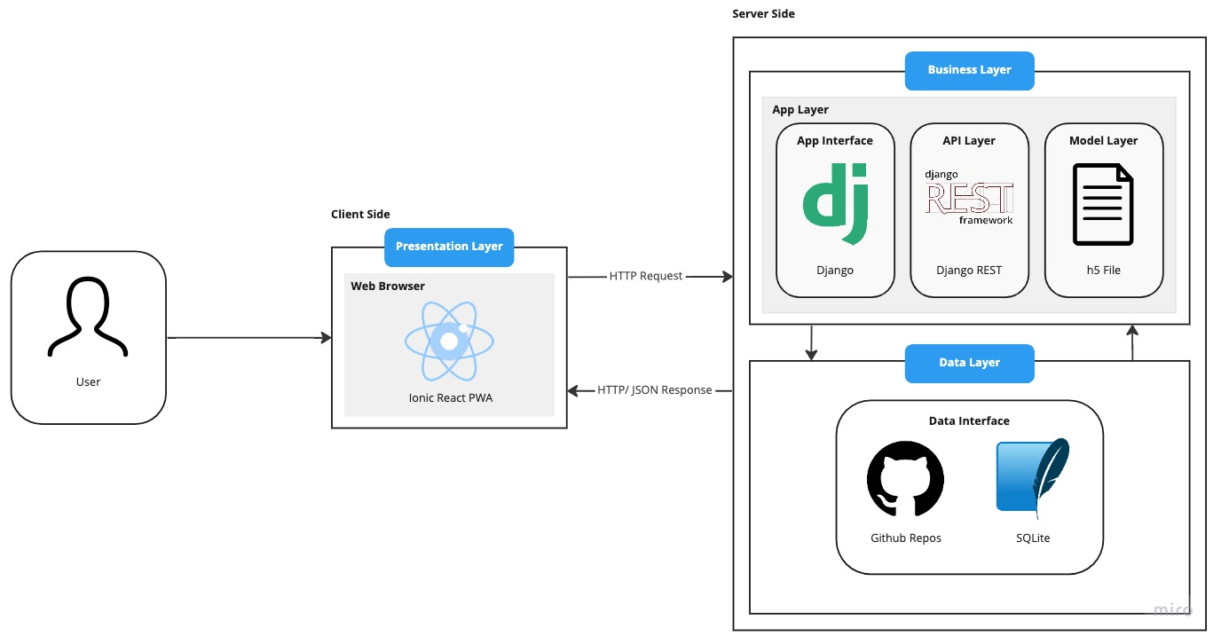
Diagrams: Architecture

Slide 16
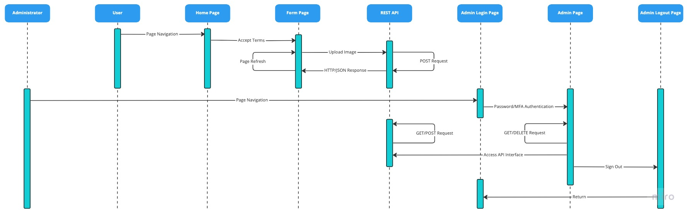
Diagrams: User Sequence

Slide 17
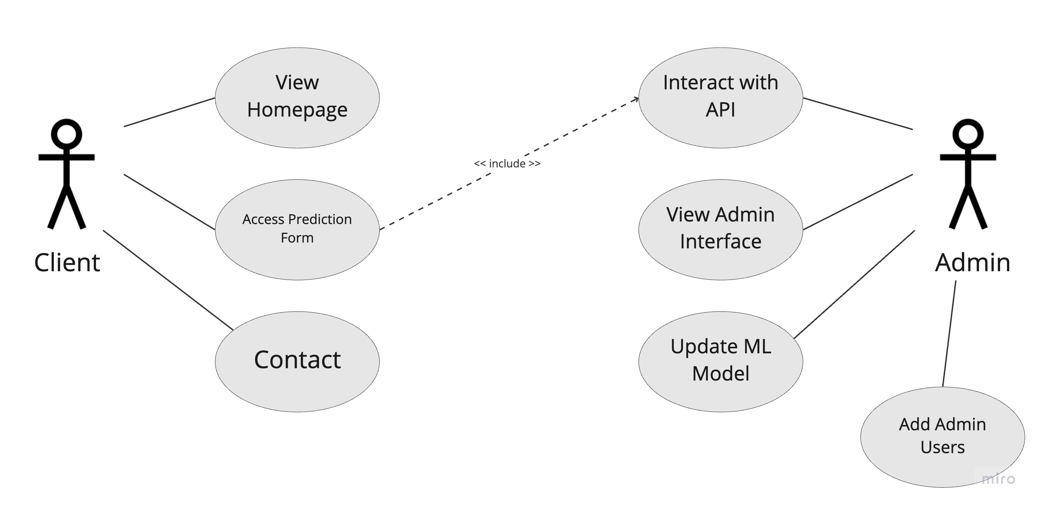
Diagrams: Use Case Diagram

Slide 18
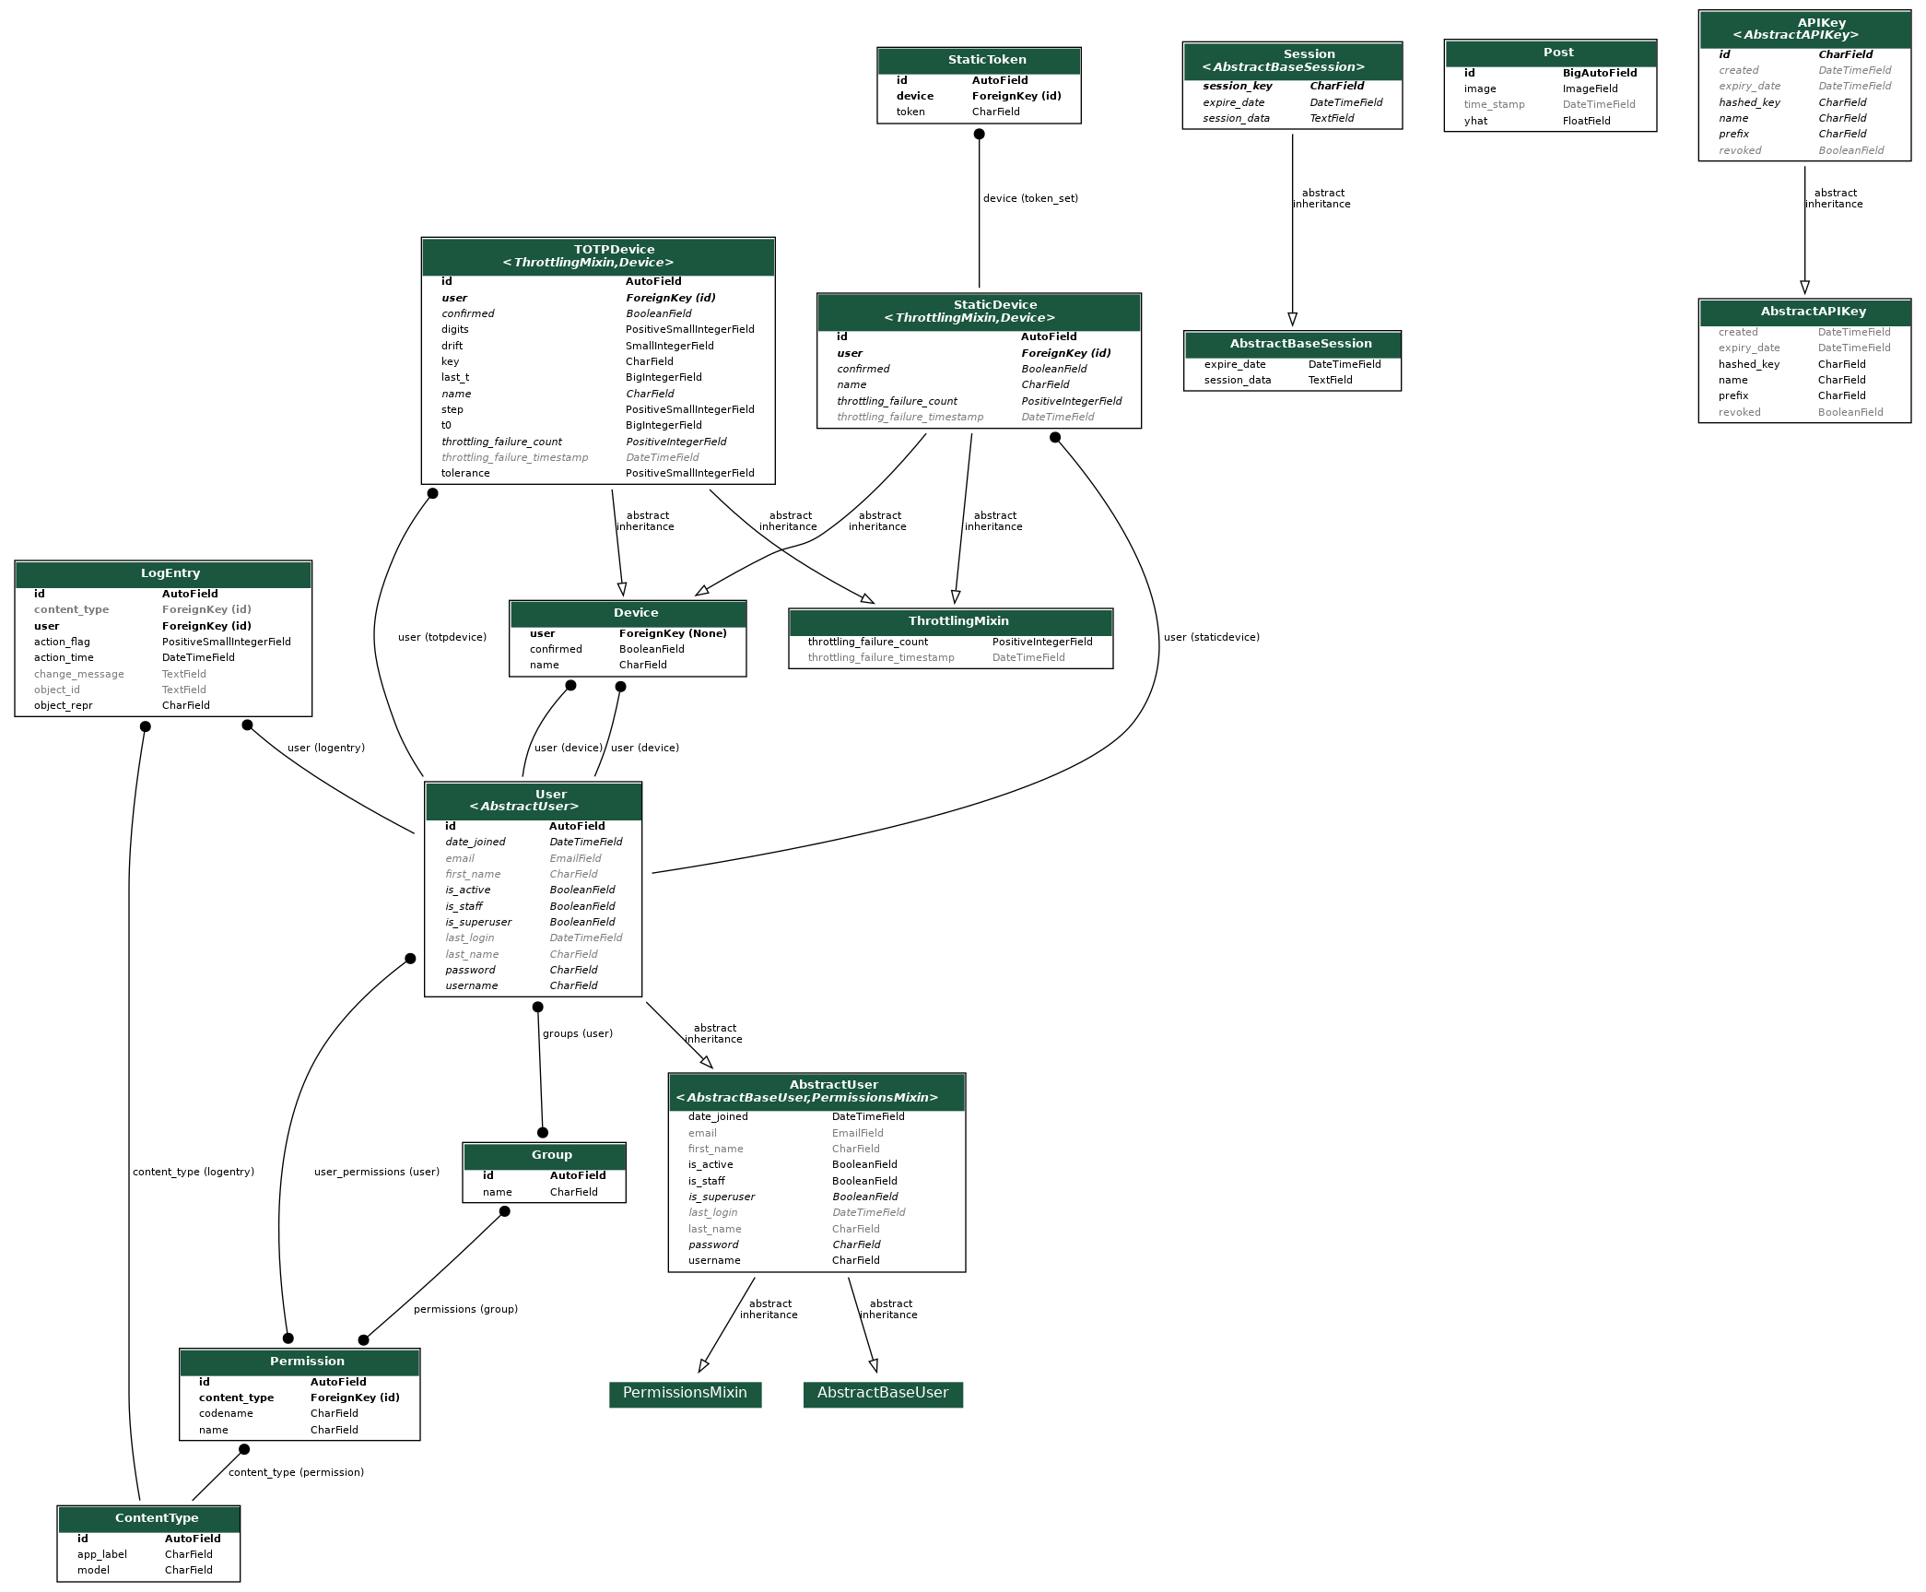
Diagrams: Class Diagram

Slide 19
Product Backlog
Issue Type | Key | Description
Task | CAP-1 | Add Django to Keras model
Task | CAP-2 | Add DRF to Keras model
Task | CAP-3 | Add a new model to optimize
Task | CAP-4 | Add more training data
Task | CAP-5 | Determine if celery is needed
Task | CAP-6 | Confirm if from front end to back end image bit path can be passed
Task | CAP-7 | Determine front end architecture
Task | CAP-8 | Determine backend web hosting
Task | CAP-9 | Implement Back End Web Hosting
Task | CAP-10 | Implement Front End Web Hosting
Task | CAP-12 | Image resizing from DRF interface to Keras model
Task | CAP-13 | Initial documentation within code
Task | CAP-14 | Enforce consistent coding style
Task | CAP-15 | Unit testing: Back End
Task | CAP-16 | End-to-End testing: Front End
Task | CAP-17 | End-to-End testing: Back End
Task | CAP-22 | Create intial ML model
Task | CAP-23 | Redo DRF backend
Task | CAP-24 | Token authentication on Django Admin
Task | CAP-25 | Combine DRF applications together
Task | CAP-27 | Capacitor/Cordova Implementation
Task | CAP-28 | Add API Key
Task | CAP-29 | Develop front end from wireframe
Task | CAP-30 | Implement Ion Loading
Task | CAP-31 | Add menu functionality
Task | CAP-32 | Presentation
Task | CAP-33 | Technical paper
Task | CAP-34 | Create Wiki Page
Task | CAP-35 | AWS S3 Buckets
Story | CAP-37 | As a user I want to be able to use this on any device so that it is convenient to use.
Story | CAP-38 | As a user I want to chat with someone or find out more information regarding the website so that I could find the answers I need.
Story | CAP-39 | As a user I want to have instant feedback as well as detailed feedback so that all data is presented to me in a transparent manner.
Story | CAP-40 | As a user I want this to have reliable and provide information about the data so that I can walk into a doctor’s appointment prepared and have a meaningful conversation.
Story | CAP-41 | As a user I want to be warned that this does not replace a physician and that I should know that before using it so that I know the limitations of this software.
Story | CAP-42 | As a user I want to interface to be easy to understand so that I don’t have to Google more information about what information I am looking at.
Story | CAP-43 | As a user I want my data to be protected so that my data and information is private.
Story | CAP-44 | As a user I want to take a photo and send it without having the photo save to my phone first so that it is easier to use than taking a photo first on my end.

Slide 20
Catalyst 1 Backlog
Issue Type | Key | Description
Task | CAP-1 | Add Django to Keras model
Task | CAP-2 | Add DRF to Keras model
Task | CAP-5 | Determine if celery is needed
Task | CAP-6 | Confirm if from front end to back end image bit path can be passed
Task | CAP-7 | Determine front end architecture
Task | CAP-8 | Determine backend web hosting
Task | CAP-12 | Image resizing from DRF interface to Keras model
Task | CAP-13 | Initial documentation within code
Task | CAP-22 | Create intial ML model
Task | CAP-23 | Redo DRF backend
Task | CAP-24 | Token authentication on Django Admin
Task | CAP-25 | Combine DRF applications together
Task | CAP-29 | Develop front end from wireframe
Task | CAP-31 | Add menu functionality
Task | CAP-32 | Presentation
Task | CAP-33 | Technical paper
Task | CAP-34 | Create Wiki Page
Story | CAP-37 | As a user I want to be able to use this on any device.
Story | CAP-41 | As a user I want to be warned that this does not replace a physician and that I should know that before using it so that I know the limitations of this software.
Story | CAP-42 | As a user I want to interface to be easy to understand so that I don’t have to Google more information about what information I am looking at.
Story | CAP-43 | As a user I want my data to be protected so that my data and information is private.

Slide 21
User Stories and Acceptance Criteria
User Story ID | Summary | Status | Place
CAP-37 | As a user I want to be able to use this on any device so that it is convenient to use. Scenario: User visiting website for the first time Given I am a role of a user When I visit this website Then I want this page to adapt to what device I am using. | Done | Platform
CAP-41 | As a user I want to be warned that this does not replace a physician and that I should know that before using it so that I know the limitations of this software. Scenario: Anxious user who is health conscious Given I am a role of a user When I am about to upload an image for prediction Then I want this page to warn me about its limitation | Done | Webpage
CAP-42 | As a user I want to interface to be easy to understand so that I don’t have to Google more information about what information I am looking at. Scenario: First time user Given I am a role of a user When I visit this webpage Then I want this page have clear information And easy to digest information for a non-medical professional | Done | Webpage
CAP-43 | As a user I want my data to be protected so that my data and information is private. Scenario: A concerned user about their data Given I am a role of a user When using this webpage Then I want my data I send into the website to be deidentified and unlabeled with my information. | Done | Platform

Slide 22
Test Cases
User Story ID | Unit to Test | Assumption | Test Data | Steps to be Executed | Expected Results
CAP-12 | Backend | NumPy array will be the same as input from ML model development | Same image from model development | Backend --> Import Image --> Print output on views.py | Same NumPy Array
CAP-24 | MFA Authentication | Two factor authentication will be successfully integrated | Admin account | Backend --> Register MFA Device --> Login | Successful authentication
CAP-22 | ML Model | ML model will output binary confidence level | Image not seen by model before | Ipynb --> Add Image --> Check Result | Result is between 0 - 1
CAP-29 | Form | Successful communication from front end to back end, otherwise error message will show | Any image | Form --> Upload Image --> Check Response | Result is between 0 - 1
CAP-37 | Platform | Webpage is device agnostic | Computer, Mobile Phone | Navigate to website | Hamburger menu on mobile, "cards" sized to screen width
CAP-43 | REST API | GET Requests will not show | Any image | Backend --> Navigate to Post Model | Message: "GET Requests not allowed"
CAP-43 | REST API | DELETE Requests for individual instances will succeed |  | Backend --> Admin Interface --> DELETE Instance | Deletion of a Post Model Instance

Slide 23
Stories Completed
Issue Type | Key | Description
Story | CAP-37 | As a user I want to be able to use this on any device so that it is convenient to use.
Story | CAP-41 | As a user I want to be warned that this does not replace a physician and that I should know that before using it so that I know the limitations of this software.
Story | CAP-42 | As a user I want to interface to be easy to understand so that I don’t have to Google more information about what information I am looking at.
Story | CAP-43 | As a user I want my data to be protected so that my data and information is private.
All stories for Catalyst 1 are completed.

Slide 24
Team Velocity

Slide 25
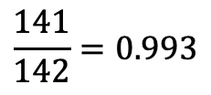
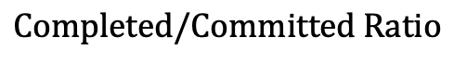
Completed/Committed Ratio
$$Completed/Committed Ratio$$
$$\frac{141}{142}=0.993$$

Slide 26
Burndown Charts

Slide 27
Retrospective

Slide 28
What Went Well
01
By utilizing Agile methodologies, every sprint was completed efficiently.
02
The tasks for every sprint were carefully considered and executed with precision.
03
Version control was managed through the use of Github and Git.
Despite a tight schedule, the work was completed on time and the minimum viable product (MVP) was successfully implemented.
04

Slide 29
What Needs Improvement
01
More time needs to be devoted to planning sprint cycles.
02
Ensure planning process is thorough before starting a sprint so that changes to sprint’s scope are minimized.
03
Detailed documentation within codebase for easier recall.
04
User story integration into sprints.

Slide 30
Next Steps
01
Spend an extra day or two for sprint planning.
02
Enforce documentation when utilizing Pylint/Eslint.
Detailed documentation within codebase for easier recall.
User story integration into sprints.

Slide 31
Catalyst 2 Backlog
Issue Type | Key | Description
Story | CAP-44 | As a user I want to take a photo and send it without having the photo save to my phone first
Story | CAP-40 | As a user I want this to have reliable and provide information about the data
Story | CAP-39 | As a user I want to have instant feedback as well as detailed feedback
Story | CAP-38 | As a user I want to chat with someone or find out more information regarding the website
Task | CAP-30 | Implement Ion Loading
Task | CAP-3 | Add a new model to optimize
Task | CAP-4 | Add more training data
Task | CAP-9 | Implement Back End Web Hosting
Task | CAP-10 | Implement Front End Web Hosting
Task | CAP-14 | Enforce consistent coding style
Task | CAP-15 | Unit testing: Back End
Task | CAP-16 | End-to-End testing: Front End
Task | CAP-17 | End-to-End testing: Back End
Task | CAP-27 | Capacitor/Cordova Implementation
Task | CAP-28 | Add API Key
Task | CAP-35 | AWS S3 Buckets

Slide 32
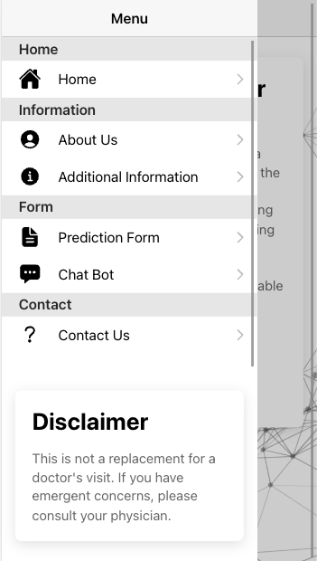
MVP Application Screenshots

Slide 33
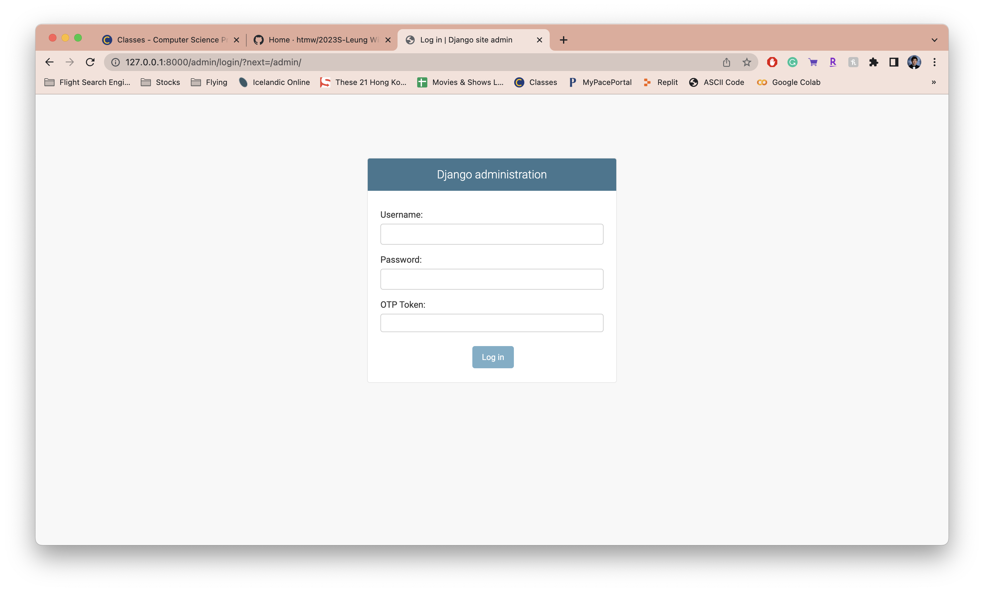
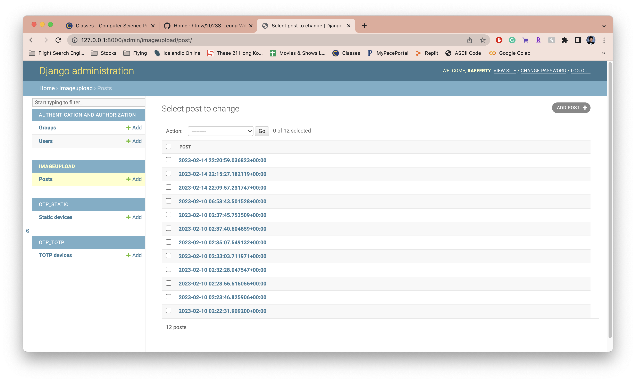
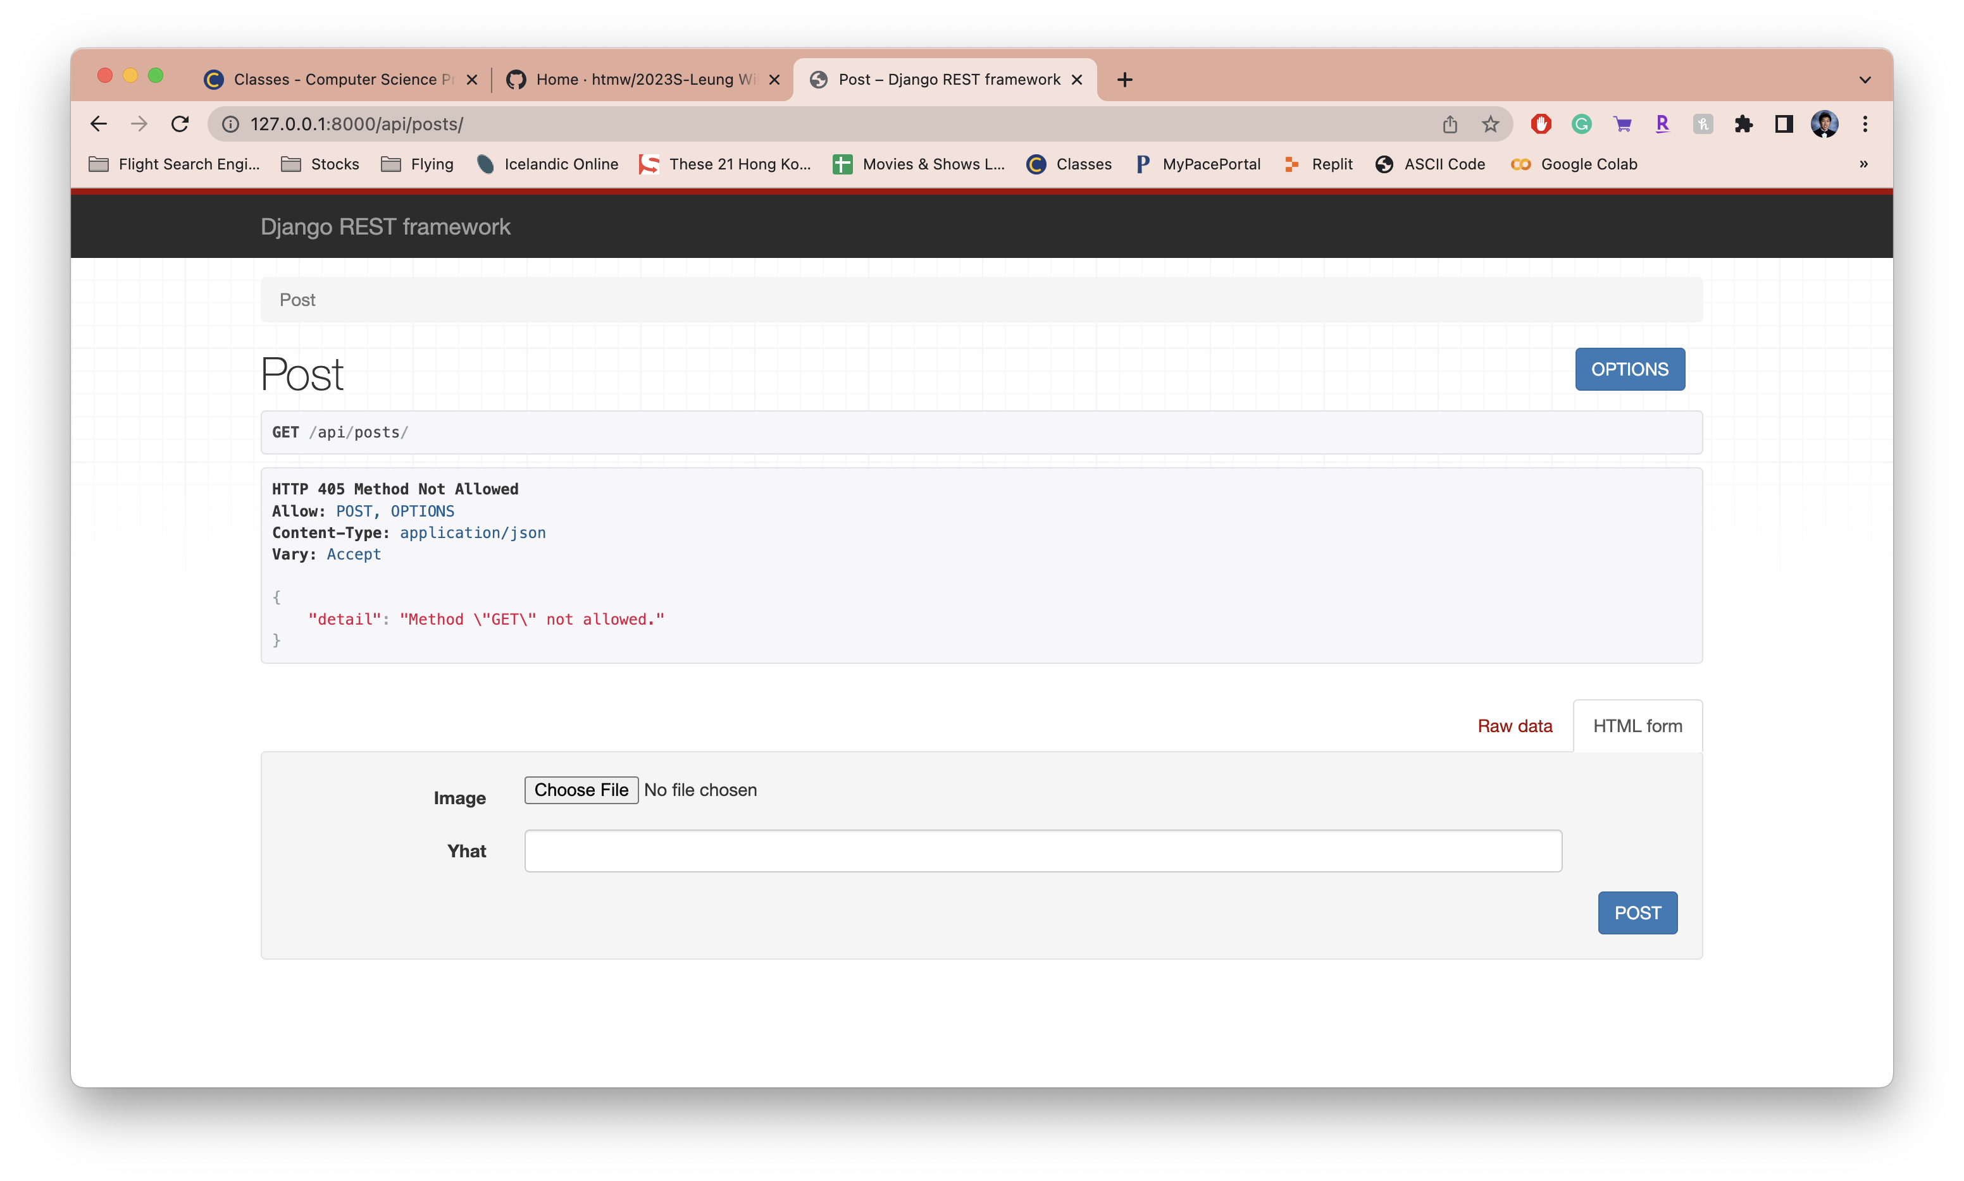
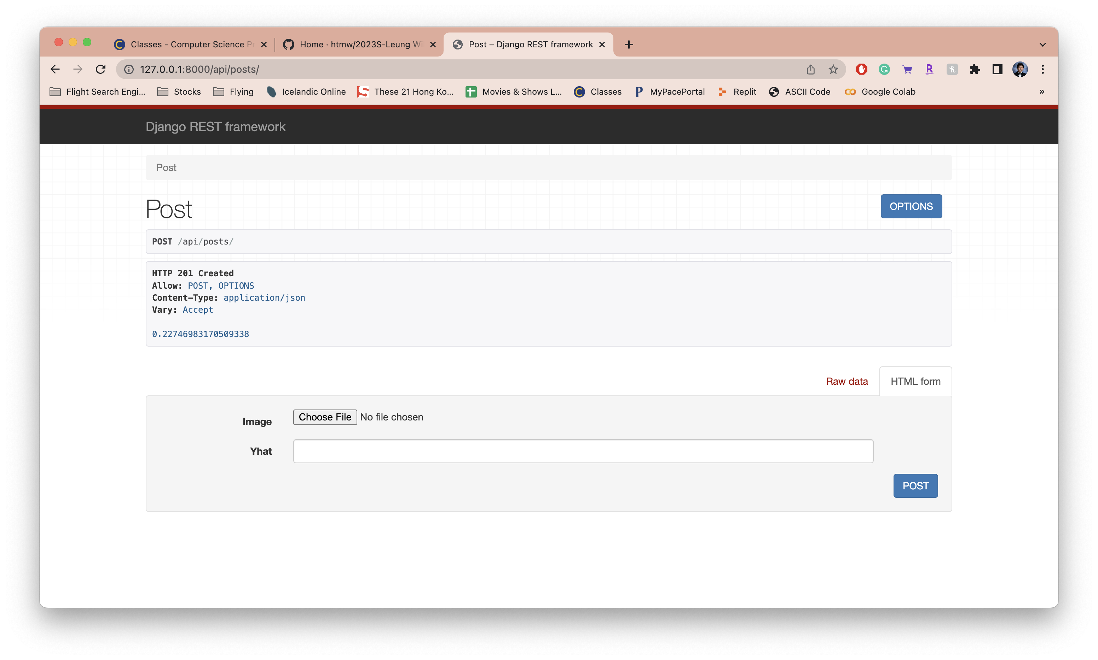
MVP API Screenshots

Slide 34
Links
GitHub: https://github.com/htmw/SpotCheckAI/wiki
MVP Video: https://youtu.be/LEKiQF-oiPE

